Slide 1
CSE 474 - Group 14
Shamir Roy - 20241015
Tanzim Rahman Sabib - 23141078
ST FARAH
RA AMIT
Page - 01

Slide 2
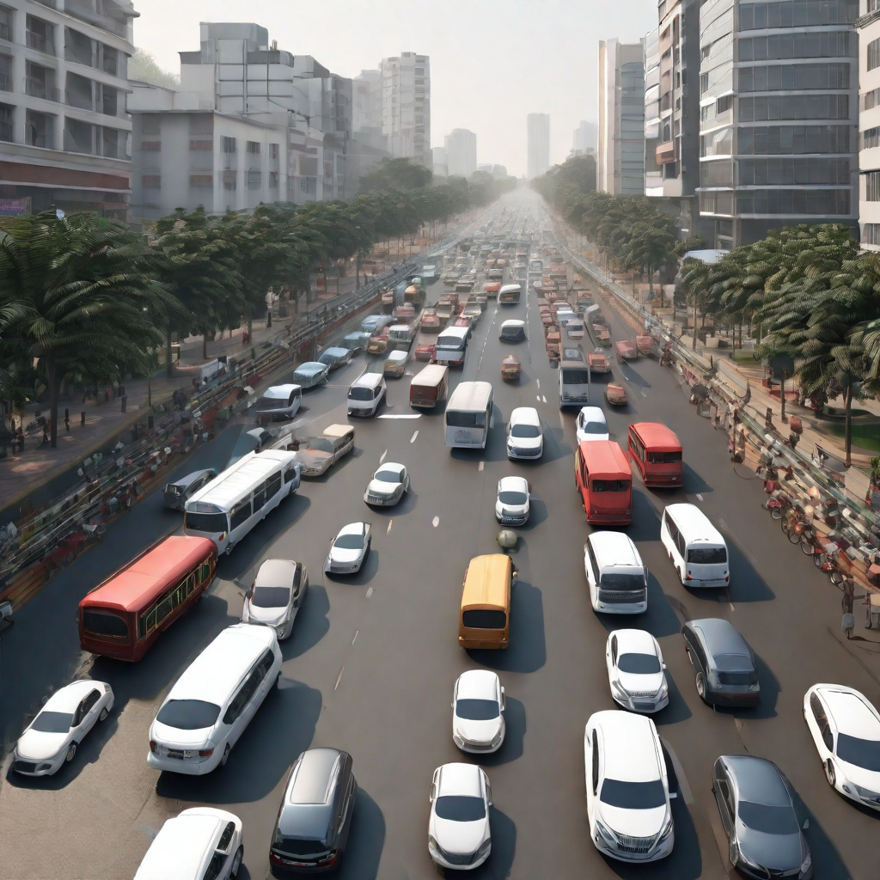
Simulating Traffic Flow in Dhaka City
Page - 02

Slide 3
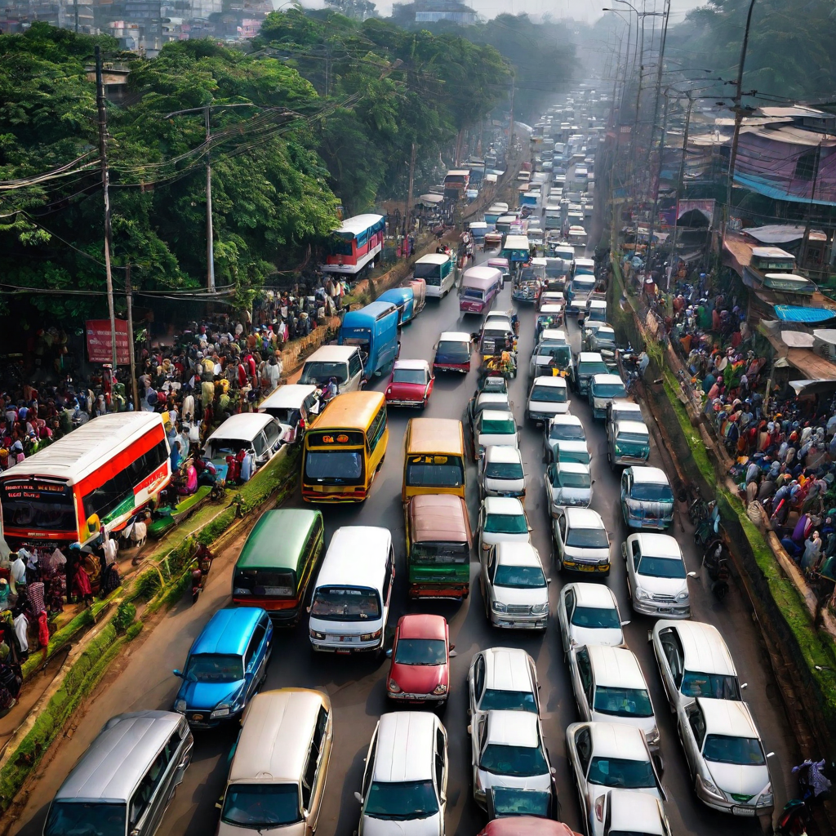
Introduction
Traffic congestion in Dhaka city is a significant issue. It leads to inconvenience, delays, and pollution. To tackle this problem, understanding traffic flow is crucial. Traffic simulation can analyze and model vehicle and pedestrian behavior, aiding in finding effective solutions. By testing different scenarios, we can enhance transportation in Dhaka and reduce congestion.
Page - 03

Slide 4
Why simulate Traffic Flow ?
The main reason behind simulating traffic flow is to generate data without real world. Instead of testing new ideas in real world we can simulate the traffic flow, test our new ideas there without having to interact with the real world. This helps accelerate the optimization and data gather of traffic systems. Simulation is much cheaper and faster alternative to real world testing.
Page - 04

Slide 5
Usefulness of traffic simulation
Traffic simulation is an important tool to enable planners to use available budgets and resources as efficiently as possible when expanding or reconstructing transportation systems. Simulation models help to understand the effects that different measures have on traffic volume and traffic flow under different circumstances. So, simulating traffic creates a solid basis for good and cost-effective decisions - making traffic and mobility safe, sustainable, equitable and resilient. In short, it helps to create future-oriented mobility. For example, the effectiveness of a flyover, bridge, tunnels or other systems can be measured using the traffic flow simulation and it helps take the most effective decision as possible and it also reduces unnecessary high costs of traffic projects. Traffic simulation also helps build more safer roads, flyover and other road stuffs.
Page - 05

Slide 6
Modeling
Traffic system models are classified into 3 categories such as -
Microscopic models - This represents every vehicle separately.
Macroscopic models - This describes the movement of vehicles as a whole in terms of traffic density and traffic flow.
Mesoscopic models - This is hybrid model that combines the features of both microscopic and macroscopic models. They model flow as “packets” of vehicles.
Page - 06

Slide 7
Related Research
1. Simulation Research on Traffic Flow Characteristics of Bus Stop Area Based on VISSIM Software - https://ieeexplore.ieee.org/document/8603540
2. Statistical traffic generation methods for urban traffic simulation - https://ieeexplore.ieee.org/document/8323712
3.. DynasTIM: A Real-time Online Traffic Simulation and Optimization System - https://ieeexplore.ieee.org/document/8996759
4. Simulation of Facilities That Ensure Adaptive Functioning of Urban Street and Road Network https://ieeexplore.ieee.org/document/9976581
5. Current Trends in Road Traffic Network Division for Distributed or Parallel Road Traffic Simulation - https://ieeexplore.ieee.org/document/9932112
Page - 07

Slide 8
Challenges
There are certain limitations and challenges of traffic simulation such as -
Challenges on model flexibility
Challenges on model look-ahead capability
Challenges on model expandability
Challenge of model consistency
Page - 08

Slide 9
Our plans
We have certain plans regarding this traffic simulation in Dhaka city such as -
Simulate traffic flow in major areas such as Mohakhali, Bijoy sarani, Banani to see how the number of traffics, speed, intersection affect traffic flow there.
To understand the cause and level of traffic jam.
To understand how to find some effective ways of solving traffic jam issue.
To understand how width of highway can affect traffic flow.
To gain enough knowledge from our simulation which we can use to find the ways of solving traffic jam.
Page - 09

Slide 10
Conclusion
To sum up, In this traffic flow simulation in Dhaka city, we simulate the traffic flow in major areas in Dhaka city where traffic jam is too much intolerable and we hope to understand the cause and effects of traffic jam in such areas using our simulation so that we can find some effective ways of solving this issue which is causing huge monetary loss in Bangladesh.
Page - 10

